Slide 1

What’s new in Oracle APEX 21.2 and beyond
Martin B. Nielsen
MBNDATA
November, 2021

Slide 2
- Oracle APEX 21.2 – New features (2021) - Oracle APEX Data Generator (pre-release)
Program

Slide 3
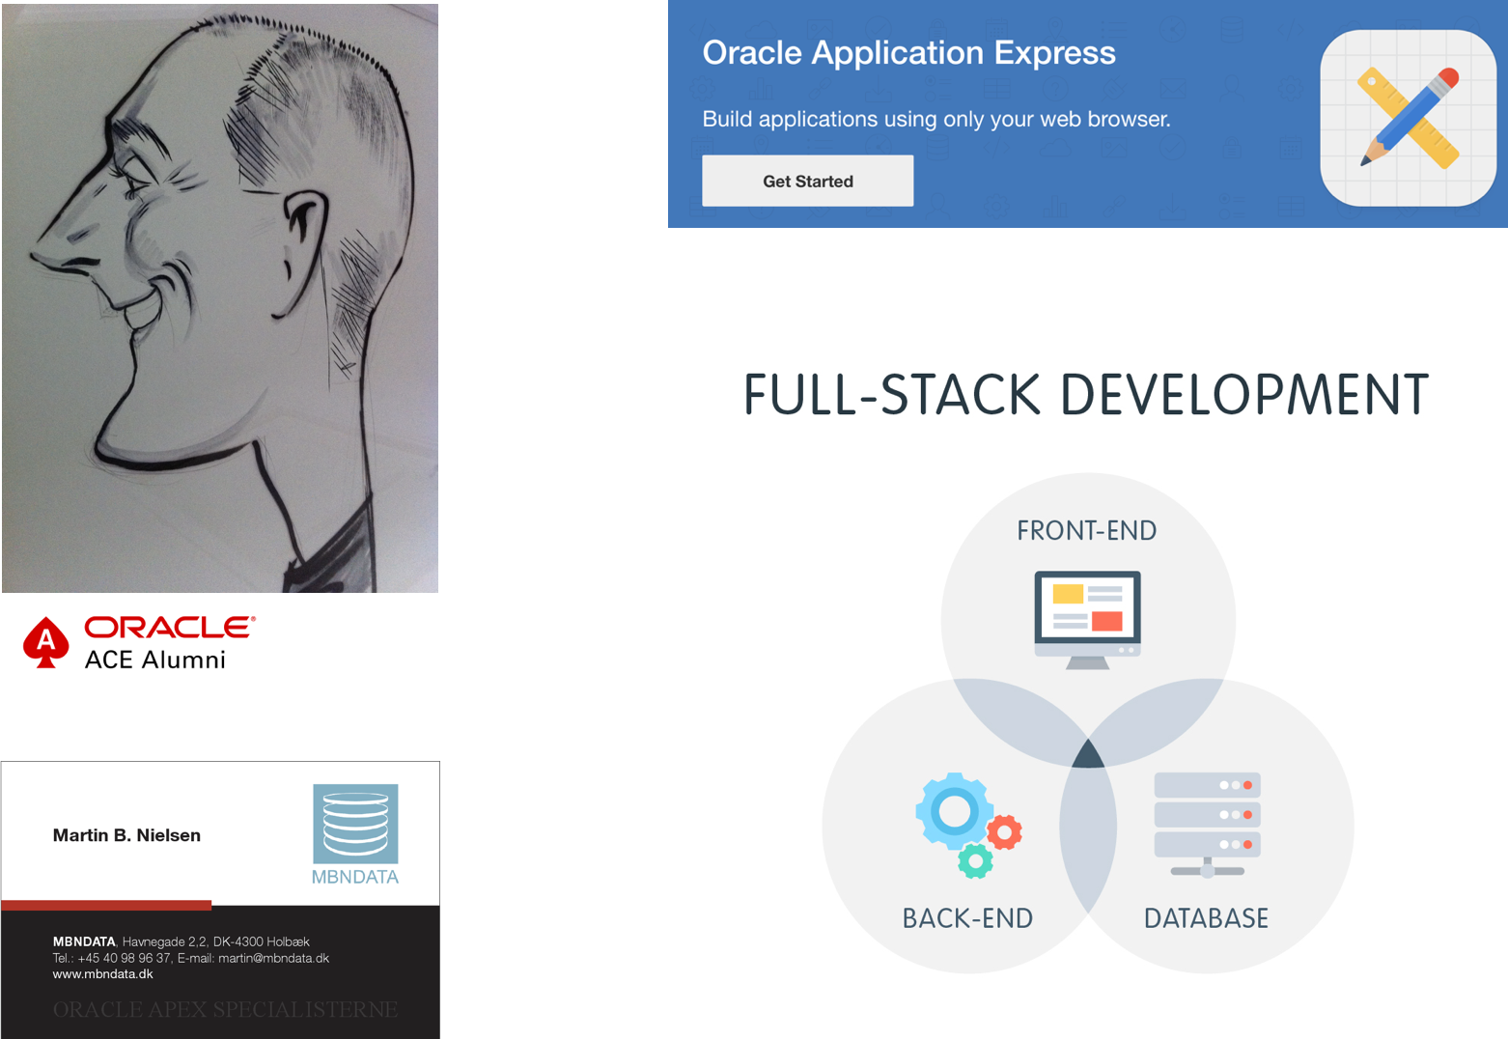
Martin B. Nielsen – Full stack APEX Developer
Firma: MBNDATA
Sted: Holbæk
Ansatte: 2
Samtidige kunder/måned: 10
Faste dage hos Danske kunder
Remote for udenlandske kunder (USA/Canada)
Projekter fra kontoret

Slide 4
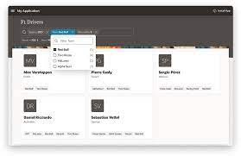

Oracle APEX 21.2 – new features
Smart filters
Progressive web apps
Geocoding & map items
REST data services
Redigering af statiske filer
Danske tekster og meddelelser
Flere page item positioner
Mere…
https://apex.oracle.com/en/platform/features/whats-new-212/

Slide 5
Demo Applikation

Slide 6
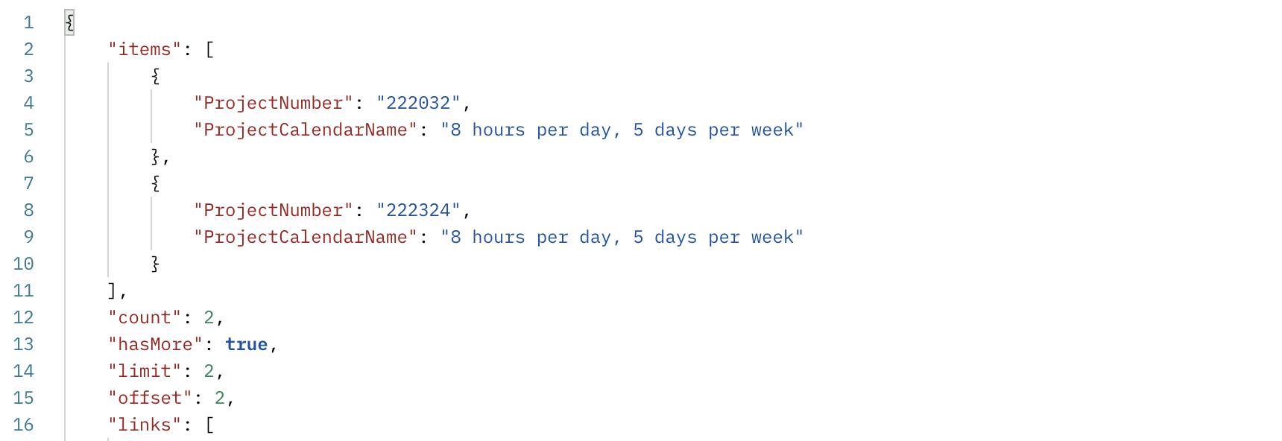
REST Call Example – ERP projects

Slide 7
Oracle APEX Data Generator (pre-release)
Generering af random, men relevant testdata
QuickSQL data generering med flere muligheder
Performance test af datamodellen
Relevante data for testere
Indsætter data direkte i datamodellen
Genererer INSERT statements
Genererer data (JSON,CSV)
Supporterer master/detail relationships

Slide 8

APEX Data Generation
Define the data you want
“Tables”
“Columns”
Output it in the format you want
CSV
JSON
Script Containing SQL Insert Statements
Direct write into existing tables
Currently only PL/SQL APIs
User interface coming
I will share a “rough” UI APP
Courtesy of Anton Nielsen, Insum Solutions

Slide 9
What’s with the Preview?
APEX Data Generation Preview in 21.2
Not Documented
Not Supported
Definitely usable
Should be fully available soon!
Already used to generate data in some samples
APEX Data Generation 22.1?
Hopefully fully supported!

Slide 10
What is required to use APEX_DG?
Oracle Database version 18 or higher
APEX 21.1 or higher
An APEX workspace
The APEX security_group_id must be set*
Can be used in PL/SQL or within an APEX Application

Slide 11
Viewing the package spec
select text
from all_source
where name = 'WWV_DG_DATA_GEN_API'
and type = 'PACKAGE'
order by line
;
select text
from all_source
where name = 'WWV_DG_OUTPUT_API'
and type = 'PACKAGE'
order by line
;

Slide 12
apex_dg_data_gen
Most Common Procedures
add_blueprint
add_table
add_column
export_blueprint
Complete blueprint definition as JSON
import_blueprint
Create a blueprint from a JSON definition (likely created by export_blueprint)
add_blueprint_from_tables (next release)
The MVP (Most Valuable Procedure)

Slide 13
apex_dg_output
Most Common Procedures
generate_data
Overloaded procedure
Generates data based upon a blueprint definition
Returns the data into a blob (output variable)
OR writes the data directly into existing tables
Less Common Procedure
preview_blueprint (next release)
Requires an APEX Application Context
Writes a few rows of sample data into APEX Collections

Slide 14
APEX_DG views
Blueprint definition views
APEX_DG_BLUEPRINTS
APEX_DG_BP_DATA_SOURCES
APEX_DG_BP_TABLES
APEX_DG_BP_TAB_COLUMNS
Utility Views
APEX_DG_BLUEPRINT_SAMPLES
APEX_DG_BUILTINS
APEX_META_TAB_COL_EXAMPLES
Builtin Data – used to create sample data
APEX_DG_BUILTIN_
2D_SHAPES
3D_SHAPES
AIRPORTS
ANIMALS
CARS
COLORS
… …
ISLANDS
LANGUAGES
LATIN_TEXTS
LOCATIONS
… …
PERSONS
PETS
… …

Slide 15
Demo Data Parser

Slide 16
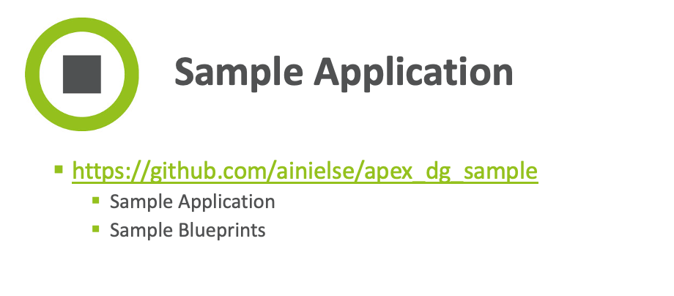
Demo Data Parser

Slide 17
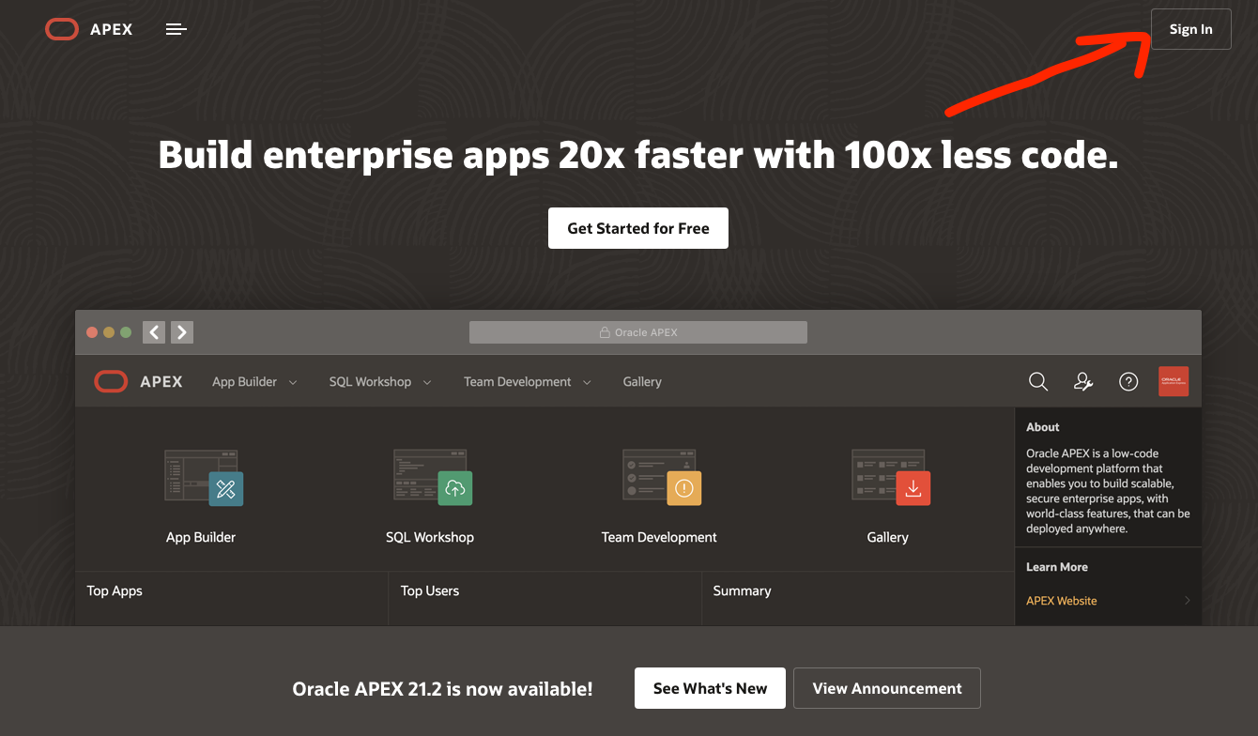
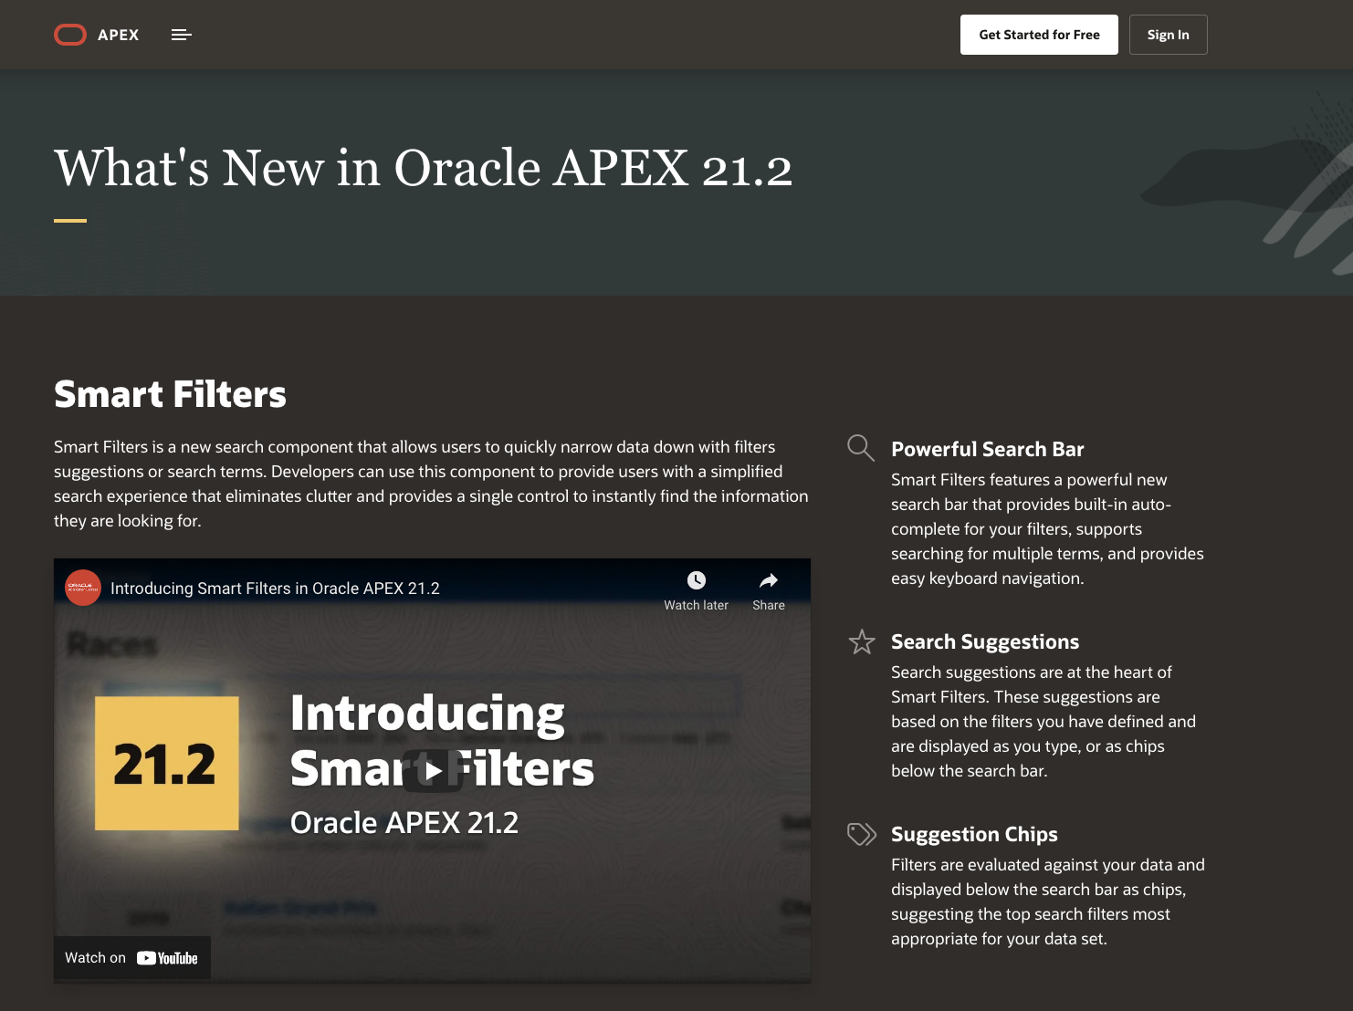
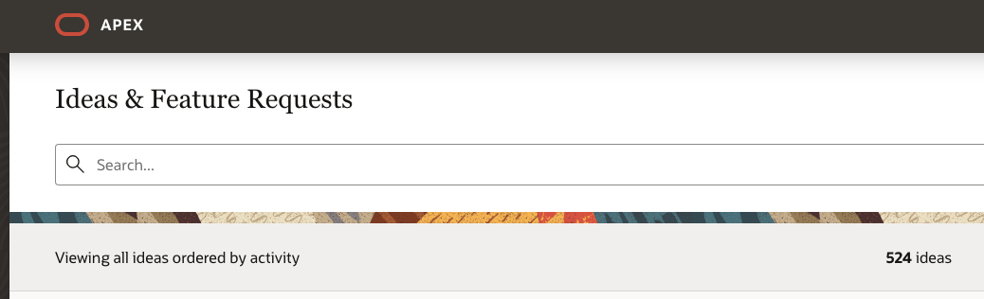
Kom godt igang
https://apex.oracle.com/en/platform/features/whats-new-212/

Slide 18
Spørgsmål ?
Martin B. Nielsen
MBNDATA
November, 2021

